Slide 1

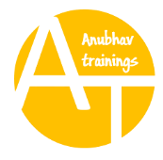
SAP S/4HANA Training
MASTER DATA GOVERNANCE (SAP MDG)
Neeraj Gupta
Session 18
SAP MDG – Data Replication Framework

Slide 2
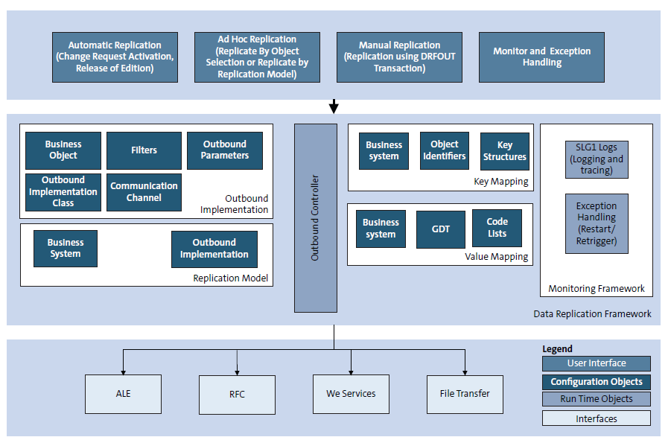
Components of Data Replication Framework
18
SAP MDG – Data Replication Framework

Slide 3
Filter Objects assigned to Tables
18
SAP MDG – Data Replication Framework

Slide 4
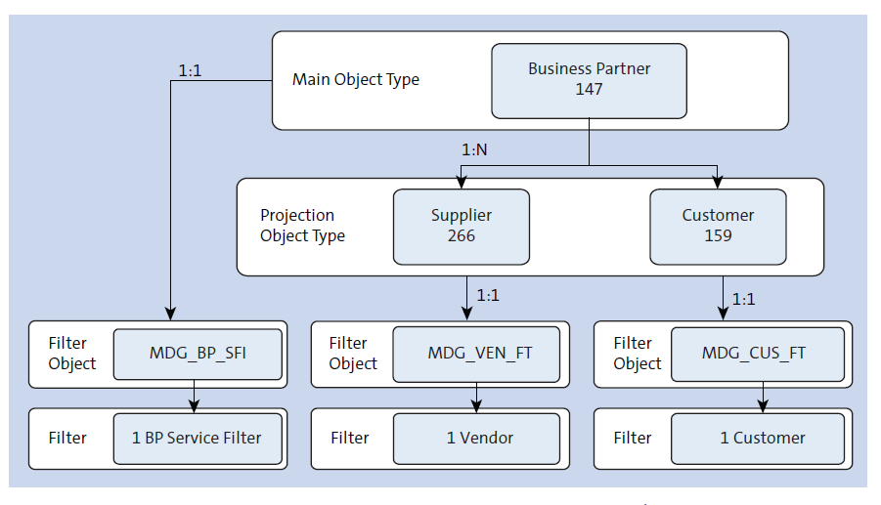
Relationships: Business Objects, Filter Objects and Filters
18
SAP MDG – Data Replication Framework

Slide 5
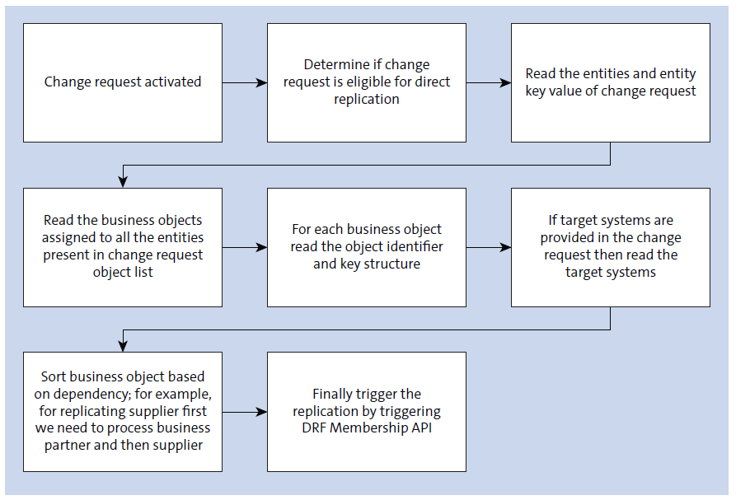
Replication Modes: Direct / Automatic Replication
18
SAP MDG – Data Replication Framework

Slide 6
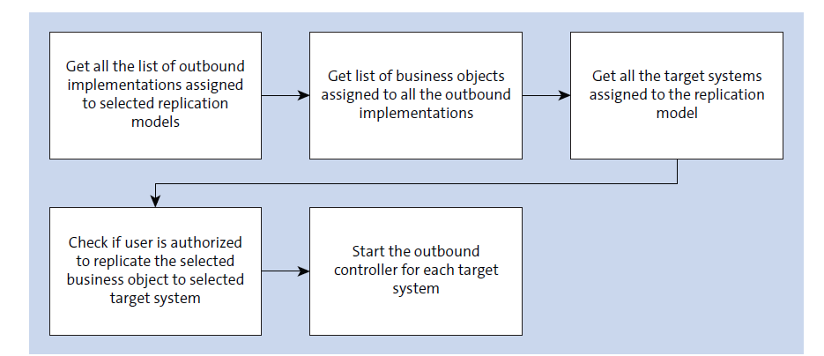
Replication Modes: Ad Hoc Replication (Application name: DRF_AD_HOC_REPLICATION)
18
SAP MDG – Data Replication Framework

Slide 7
18
SAP MDG – Data Replication Framework
DRF Web Dynpro Applications

Slide 8
18
SAP MDG – Data Replication Framework
DRF Key Mapping

Slide 9
18
SAP MDG – Data Replication Framework
Change of DRF change pointer generation

Slide 10

End of Session18

Slide 11

Questions

Slide 12

Neeraj gupta

Slide 13


We’re committed to empower you to be
Most Desirable Resource
through powerful training solutions.
We build the workforce of the future.
250+
Corporate Clients
30,000+
Learners Trained
25000+
Learners Placed
FREE WEBINARS
Sign up for free webinars with industry experts every fortnight!
Enroll Now!
Contact us today!
https://anubhavtrainings.com/

Slide 14




More from AnubhavTrainings.com

